Slide 1
System of
Linear Equations
B.1

Slide 2






Equation Solving
A
B
Root
Finding
Linear
Algebra
non-linear
Single variable
linear
Multi variable
Open
Methods
Brackting
Methods
Direct
Methods
Iterative
Methods
Iterative
False-
position
Gauss
elimination
Jacobi’s
Newton-
Rapson
Bisection
Gauss-
Jordan
Gauss-Seidel
Secant
Choleski’s

Slide 3
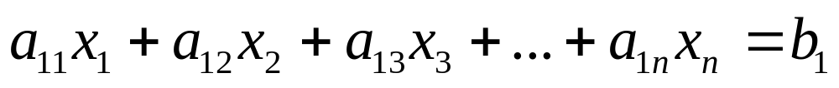

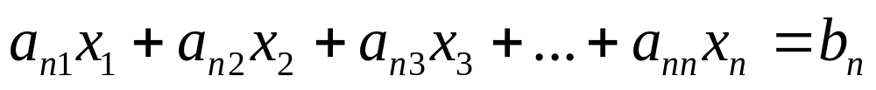
System of Linear Equations
A set of n equations and n unknowns
. .
. .
. .

Slide 4
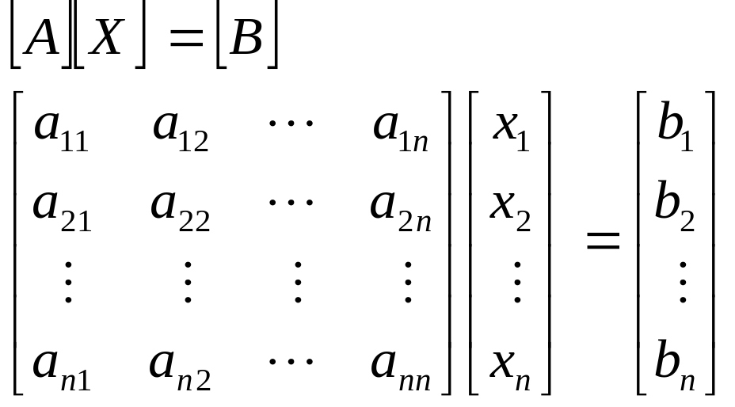
Gaussian Elimination
One of the most popular techniques for solving simultaneous linear equations of the form
Consists of 2 steps
1. Forward Elimination of Unknowns.
2. Back Substitution

Slide 5
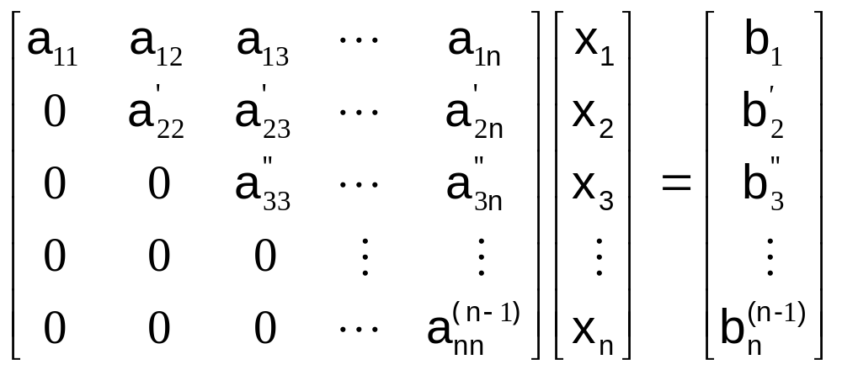
Forward Elimination
In general we get:

Slide 6
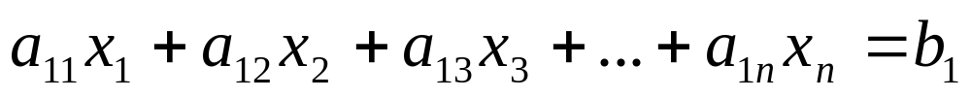
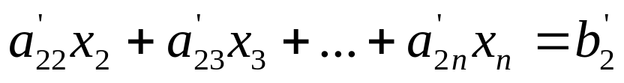
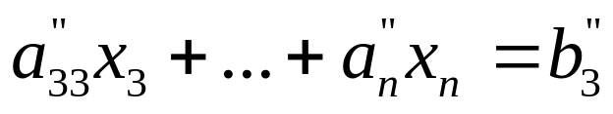
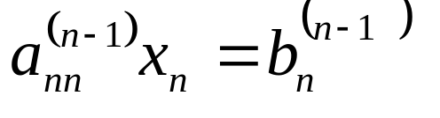
Forward Elimination
At the end of (n-1) Forward Elimination steps, the system of equations will look like:
. .
. .
. .

Slide 7
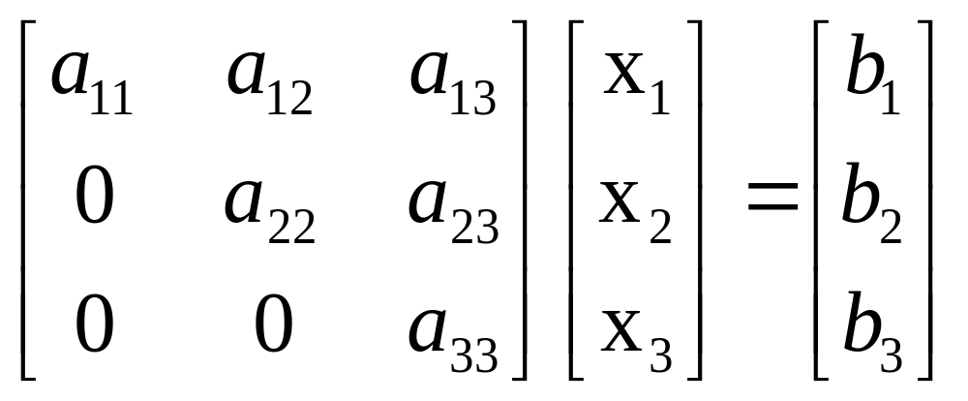
Back Substitution
The goal of Back Substitution is to solve each of the equations using the upper triangular matrix.
Example of a system of 3 equations

Slide 8
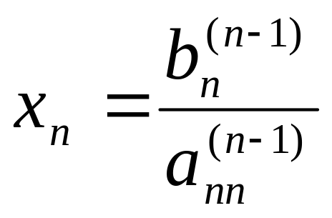
Back Substitution
Start with the last equation because it has only one unknown
Solve the second from last equation (n-1)^{th} using x_{n} solved for previously.
This solves for x_{n-1}.

Slide 9
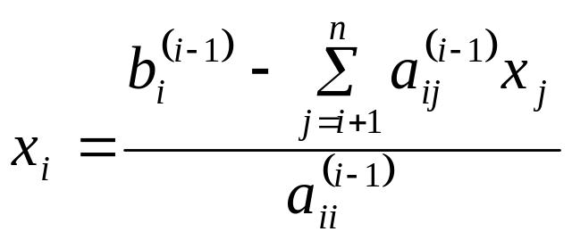

Back Substitution
Representing Back Substitution for all equations by formula
For i=n-1, n-2,….,1
and

Slide 10

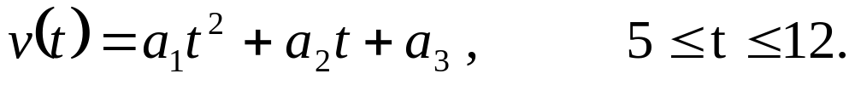
Example: Rocket Velocity
The upward velocity of a rocket is given at three different times
Time, t (s) | Velocity, v (m/s)
5 | 106.8
8 | 177.2
12 | 279.2
The velocity data is approximated by a polynomial as:
Find: The Velocity at t=6,7.5,9, and 11 seconds.

Slide 11

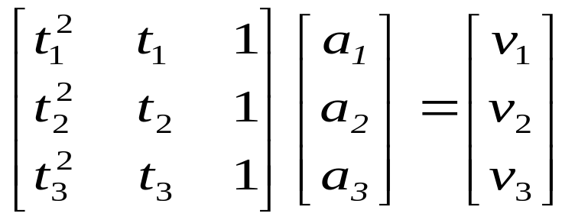

Example: Rocket Velocity
Assume
Results in a matrix template of the form:
Using date from the time / velocity table, the matrix becomes:

Slide 12
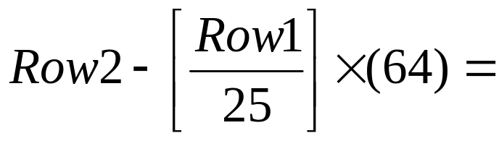
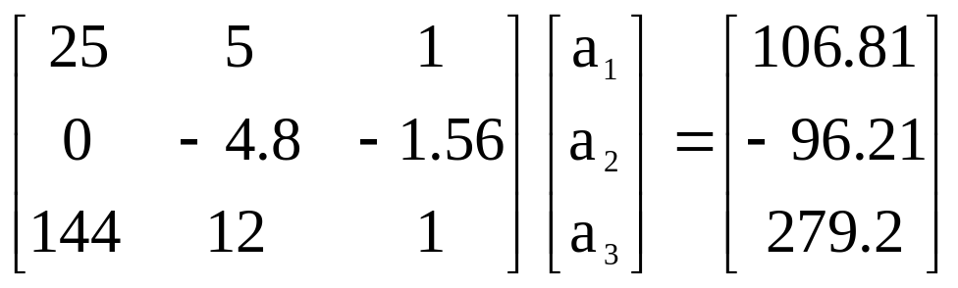
Example: Rocket Velocity
Forward Elimination: Step 1
Yields

Slide 13
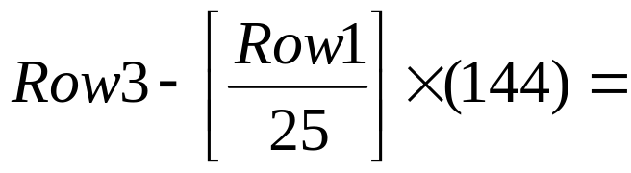
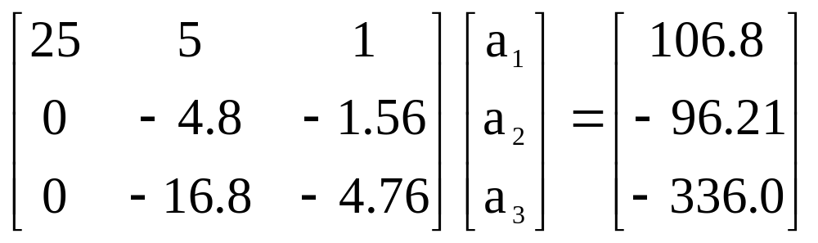
Example: Rocket Velocity
Forward Elimination: Step 1
Yields

Slide 14
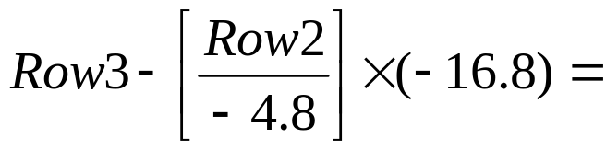
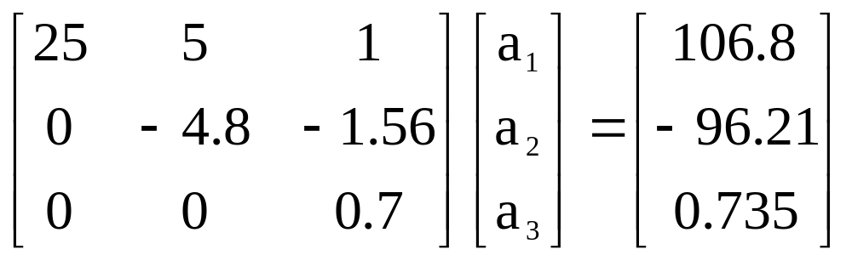
Example: Rocket Velocity
Forward Elimination: Step 2
Yields
This is now ready for Back Substitution

Slide 15
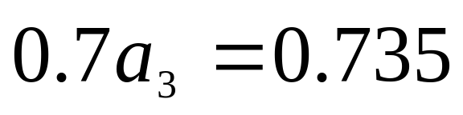
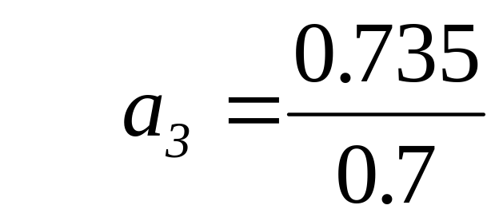

Example: Rocket Velocity
Back Substitution:
Solve for a₃ using the third equation

Slide 16
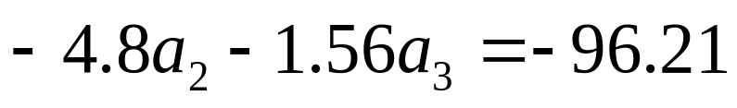
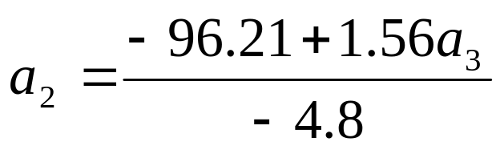
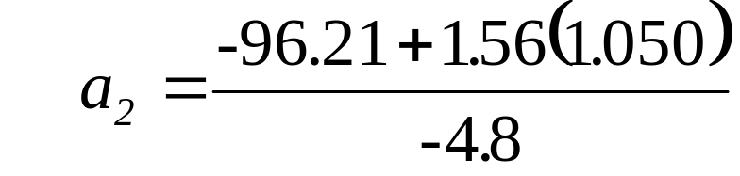
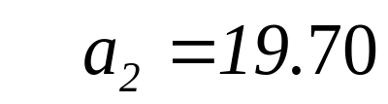
Example: Rocket Velocity
Back Substitution:
Solve for a₂ using the second equation

Slide 17
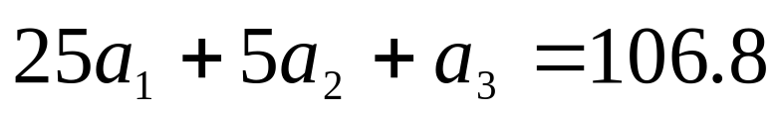
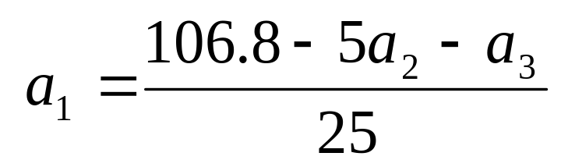
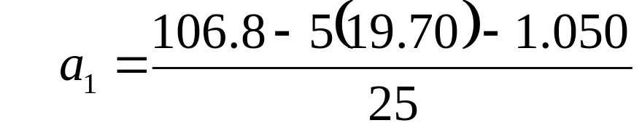

Example: Rocket Velocity
Back Substitution:
Solve for a₁ using the first equation

Slide 18
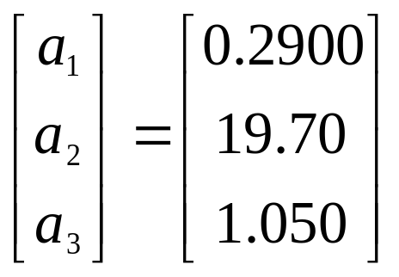
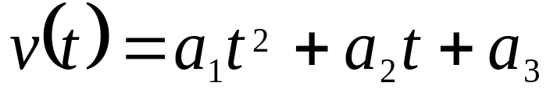
Example: Rocket Velocity
Solution:
The solution vector is
The polynomial that passes through the three data points is then:

Slide 19
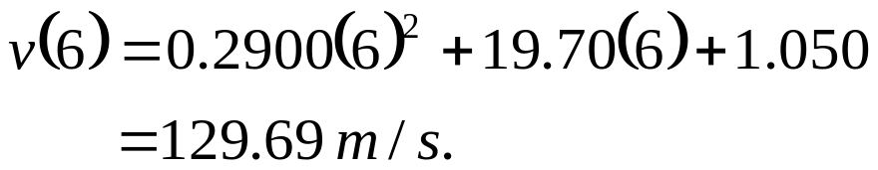
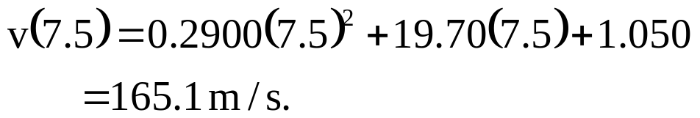
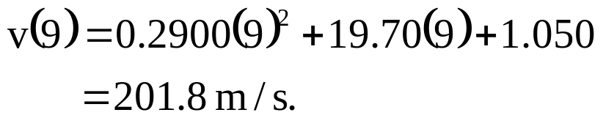
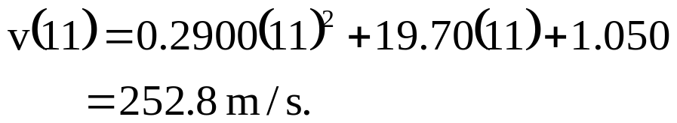
Example: Rocket Velocity
Solution:
Substitute each value of t to find the corresponding velocity

Slide 20
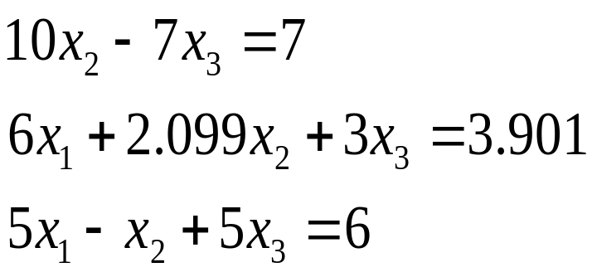
Pitfalls
Two Potential Pitfalls
Division by zero: May occur in the forward elimination steps. Consider the set of equations:
- Round-off error: Prone to round-off errors.

Slide 21
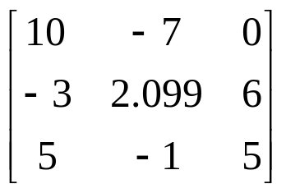
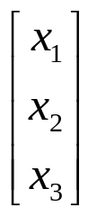
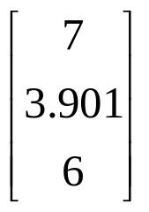
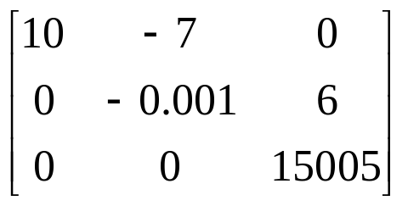

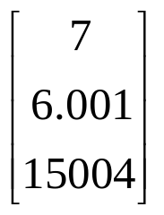
Pitfalls: Example
Consider the system of equations:
Use five significant figures with chopping
=
At the end of Forward Elimination
=

Slide 22
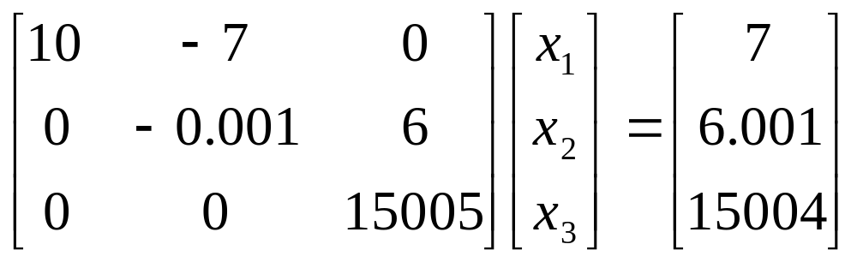
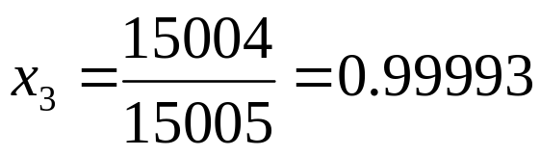
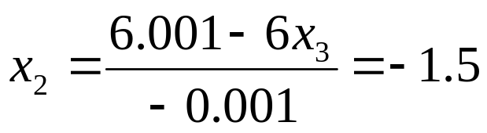
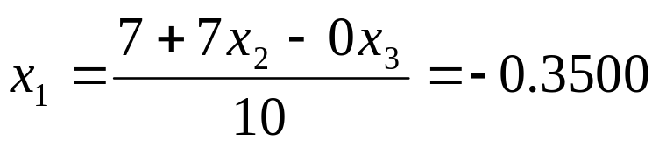
Pitfalls: Example
Back Substitution

Slide 23
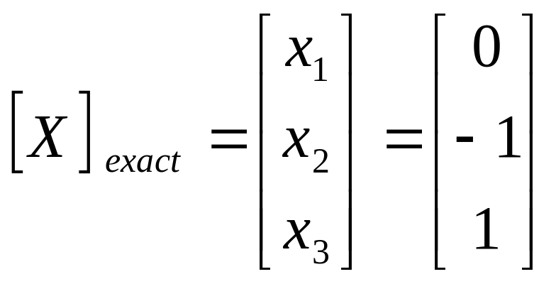
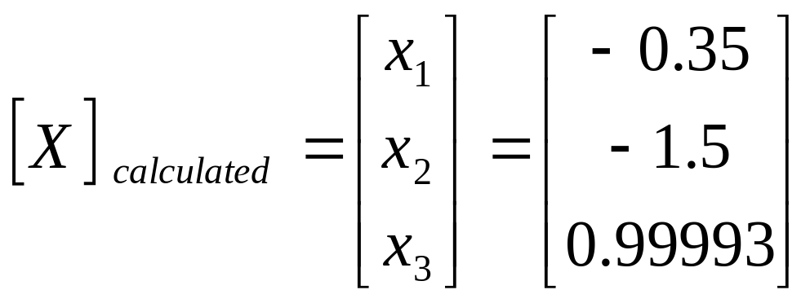
Pitfalls: Example
Compare the calculated values with the exact solution

Slide 24
Improvements
Increase the number of significant digits
Decreases round off error
Does not avoid division by zero
Gaussian Elimination with Partial Pivoting
Avoids division by zero
Reduces round off error

Slide 25
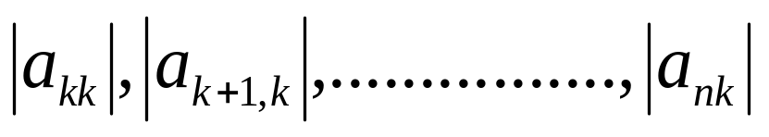
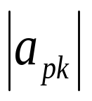

Partial Pivoting
Gaussian Elimination with partial pivoting applies row switching to normal Gaussian Elimination.
How?
At the beginning of the k^{th} step of forward elimination, find the maximum of
If the maximum of the values is
In the p^{th} row,
then switch rows p and k.

Slide 26
Partial Pivoting
What does it Mean?
Gaussian Elimination with Partial Pivoting ensures that each step of Forward Elimination is performed with the pivoting element |a_{kk}| having the largest absolute value.

Slide 27
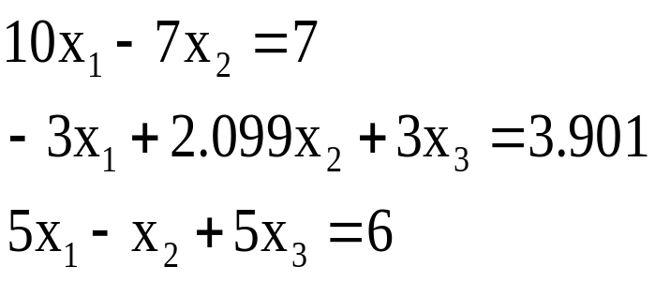
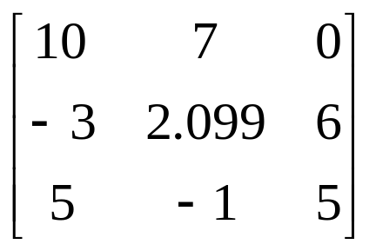


Partial Pivoting: Example
Consider the system of equations
In matrix form
=
Solve using Gaussian Elimination with Partial Pivoting using five significant digits with chopping

Slide 28



Partial Pivoting: Example
Forward Elimination: Step 1
Examining the values of the first column
|10|, |-3|, and |5| or 10, 3, and 5
The largest absolute value is 10, which means, to follow the rules of Partial Pivoting, we switch row1 with row1.
Performing Forward Elimination

Slide 29

Partial Pivoting: Example
Forward Elimination: Step 2
Examining the values of the first column
|-0.001| and |2.5| or 0.0001 and 2.5
The largest absolute value is 2.5, so row 2 is switched with row 3
Performing the row swap

Slide 30

Partial Pivoting: Example
Forward Elimination: Step 2
Performing the Forward Elimination results in:

Slide 31



Partial Pivoting: Example
Back Substitution
Solving the equations through back substitution

Slide 32


Partial Pivoting: Example
Compare the calculated and exact solution
The fact that they are equal is coincidence, but it does illustrate the advantage of Partial Pivoting

Slide 33
Summary
Forward Elimination
Back Substitution
Pitfalls
Partial Pivoting

Slide 34
Thanks to Prof. Autar Kaw for his wonderful slides

